Slide 1


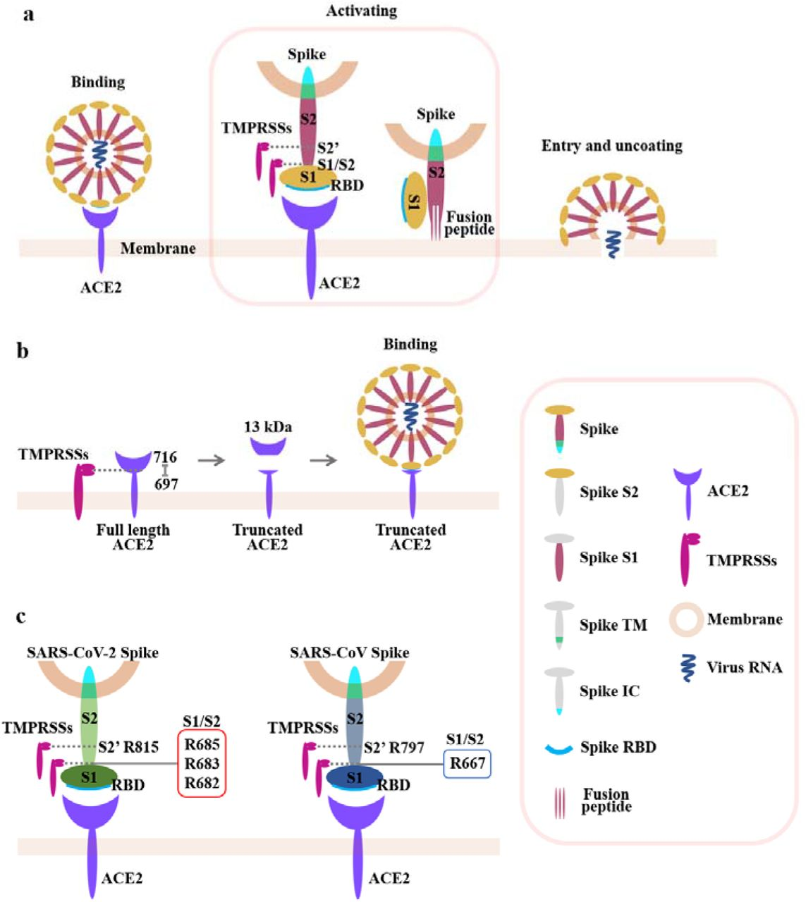
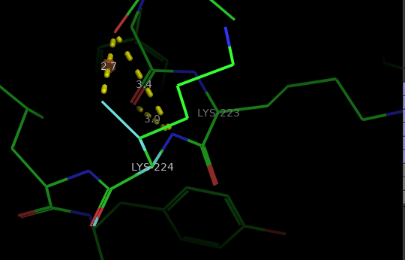
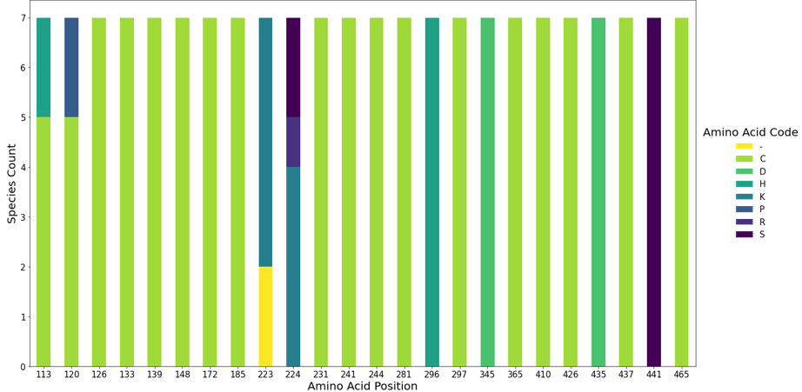
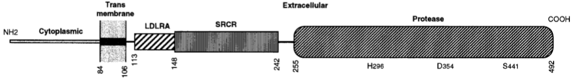
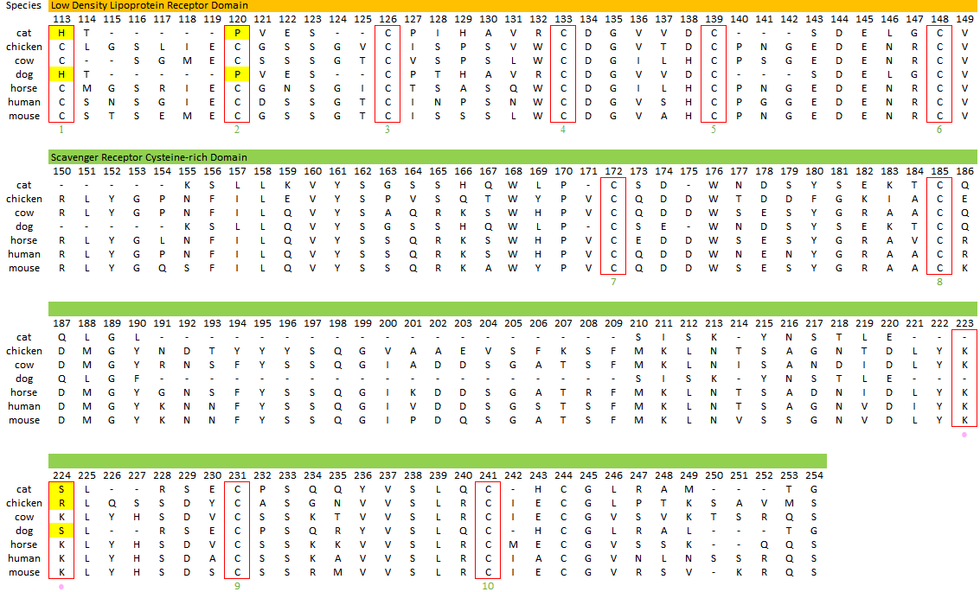
The Cleavage Potential of Cross-Species TMPRSS2 Variants toward SARS-CoV-2 S2’ Subunit
Tyshawn Ferrell ^{1,2}, Kelly Pierce ¹, Johnny Aldan ¹, Ethan Ho ¹, Dairian Balai ¹
¹Texas Advance Computing Center, University of Texas at Austin, Austin, TX, 78712-78758
²Department of Biology, Albany State University, Albany, GA 31705
Severe acute respiratory syndrome coronavirus 2 (SARS-CoV-2), a positive-stranded RNA virus, has caused >100,000 infections and >50,000 deaths during the 2020 pandemic. SARS-CoV-2 successful infectivity is in part due to structural motifs and specific cell receptor targeting. SARS-CoV-2 spike (S) glycoprotein mediates cell attachment by recognizing the angiotensin converting enzyme II (ACE2) receptor, which initializes cleavage by host cell proteases to induce cell membrane fusion. In previous studies transmembrane protease/serine subfamily member 2 (TMPRSS2) have increased cleavage efficiency towards the S protein subunits. This study aims to characterize cross-species variants of TMPRSS2 and their potential to cleave S proteins subunits in silico. We hypothesize that TMPRSS2 aids in the spillover of SARS-CoV-2 to alternate host by having a conserved catalytic region. We investigated the conservation of TMPRSS2 sequences amongst several species and to the human homolog. We utilized protein databanks to form concise amino sequence alignments of six domestic animals for comparisons with the human variant. We characterized differences in catalytically important residues based off the position specific score and changes in amino acid properties. We found that important residues within TMPRSS2 are highly conserved and found only substitutions likely to have minor effect on catalytic activity. This study has provided insight on possible spillover into alternate host with structurally similar TMPRSS2 variants compared to humans, posing an immense threat for epidemics in domesticated animal populations.
INTRODUCTION
RESULTS
Cats and Dogs have Ser residues (cyan) at position 224 that have increased percent buried (19.60∆), but is more Hydrophobic compare to Lys residues in other species
TMPRSS2 is a vital host cell protease that activates SARS-CoV-2 by cleaving the S2 subunit
Conservation of TMPRSS2 varied slightly amongst seven mammalian species
Notably differences at positions 113,120,223, and 244 may alter disulfide bond formation and monobasic cleavage recognition sites
Meng and et, 2020, BioRxiv
Differences in the Low-Density Lipoprotein and Scavenger receptor domain in select species are comprised of residues with majority unidentical physiochemical properties
FUTURE PLANS
Genetic strategies to construct the F2 populations and measure recombination frequency
Obtain the complete crystal structure of TMPRSS2 and compare it to the predicted model produced by SWISS-MODEL.
Investigate how the differences in specific residues effect the catalytic efficiency to cleave monobasic Arg residues in vivo.
Explore sequence alignments for other species and analyze data for variation within each species at a nucleotide level. Create a cross-species phylogenic tree of TMPRSS2 variants.
Paoloni-Giacobino and et, 1997, Genomics
MATERIALS & METHODS
We retrieved 9,757 TMPRSS2 protein sequences from 120 species from EggN0G and used Clustal Omega TO verified the authenticity of each alignment in the EggN0G dataset.
We then filtered out target mammalian species (Homo sapiens, Mus musculus, Canis Lupus familiaris, Felis catus, Bos Taurus, Equus caballus, and Gallus gallus) from the multiple sequence alignment of all 120 species
From the target species list we extracted the H. sapien homolog sequence based upon UniProt’s TMPRSS2 homolog.
For each non-human species, we selected a sequence for comparison by choosing the sequence record with the greatest percent identity to human TMPRSS2. We used a position specific score matrix (PSSM) to find the percent probability of a particular residue at a specific location.
Each substitution at a residue of interest was categorized as a mutation, which was then analyzed for its property difference based on percent buried, van der wals volume, and hydrophobicity data from previous studies [Darby, 1993; Schein, 1990; Radzicka, 1988].
We retrieved the predicted structure of TMPRSS2 from SWISS-MODEL.
We modified the structure of TMPRSS2 in Pymol to visualize sequence comparisons.
ACKNOWLEDGEMENTS
This research was supported by the Texas Advanced Computing Center (TACC) and the Cyber-Infrastructure for Social Change REU, which was funded by the National Science Foundation award #1852538. A special thanks to TACC faculty and project mentors for their encouragement and support.
REFERENCES
Legend
Meng, T., Cao, H., Zhang, H., Kang, Z., Xu, D., Gong, H., ... & Wei, H. (2020). The insert sequence in SARS-CoV-2 enhances spike protein cleavage by TMPRSS. BioRxiv.
Paoloni-Giacobino, A., Chen, H., Peitsch, M. C., Rossier, C., & Antonarakis, S. E. (1997). Cloning of the TMPRSS2 gene, which encodes a novel serine protease with transmembrane, LDLRA, and SRCR domains and maps to 21q22. 3. Genomics, 44(3), 309-320.
Darby, N. J., & Creighton, T. E. (1993). Protein structure. Oxford University Press, USA.
Schein, C. H. (1990). Solubility as a function of protein structure and solvent components. Bio/technology, 8(4), 308-317.
Radzicka, A., & Wolfenden, R. (1988). Comparing the polarities of the amino acids: side-chain distribution coefficients between the vapor phase, cyclohexane, 1-octanol, and neutral aqueous solution. Biochemistry, 27(5), 1664-1670.
Pink circles = Monobasic recognition site
Red rectangles = Important structural and catalytic residues
Highlighted cells = Non-identical residues based upon physiochemical properties
Green numbers = Number of cysteines that form disulfide bonds
Notes:
I added the reference to the pictures and for some reason the format shifted some images.

Slide 2

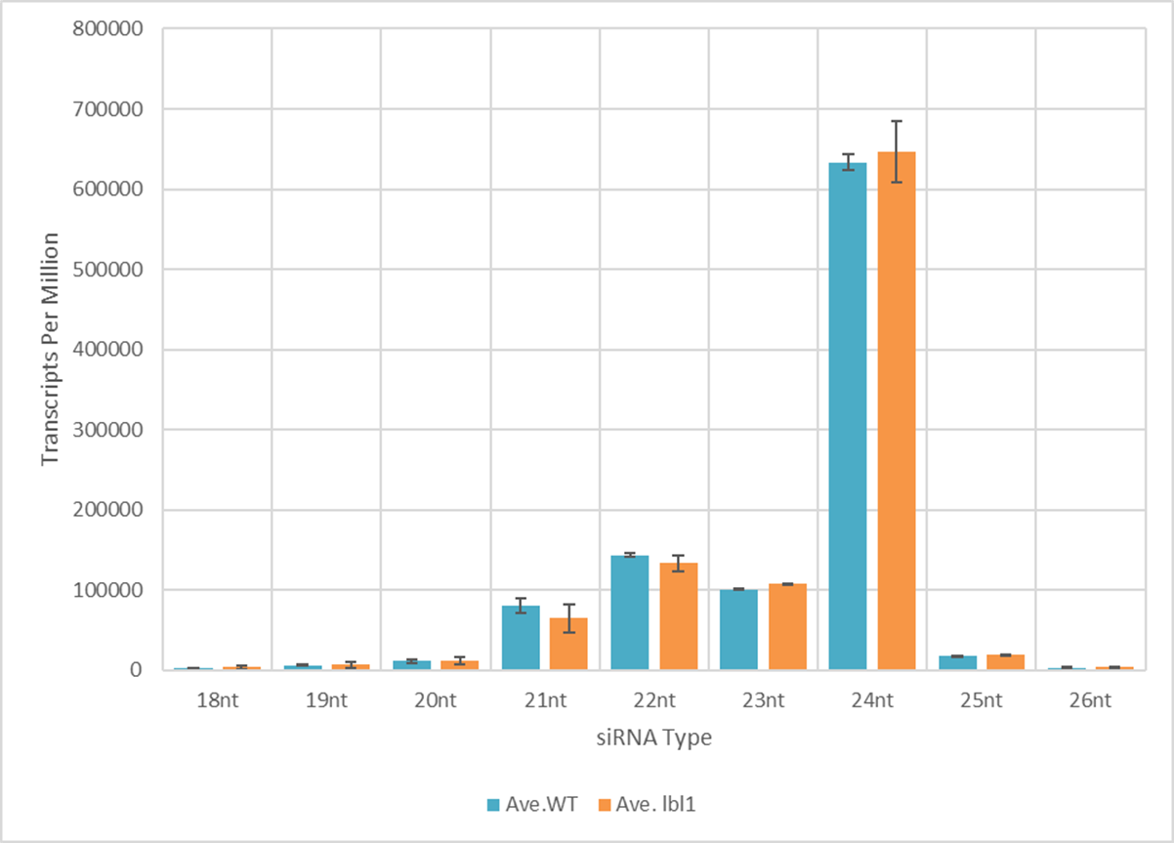
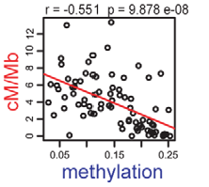
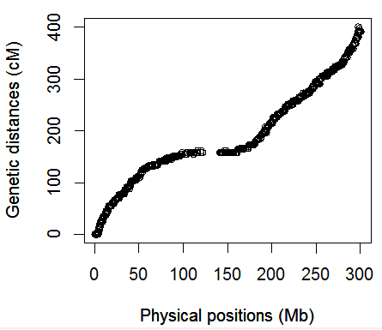
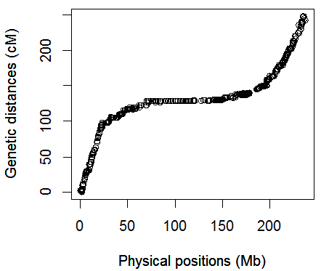
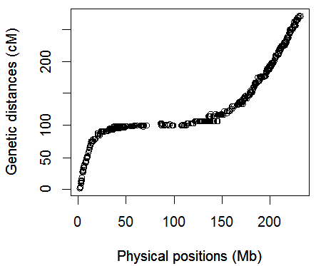
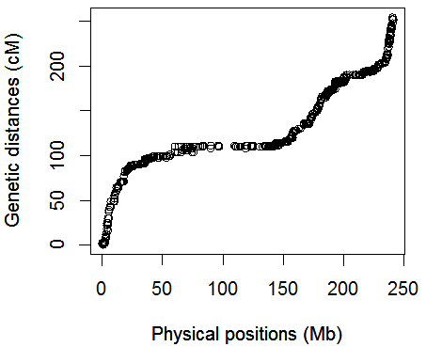
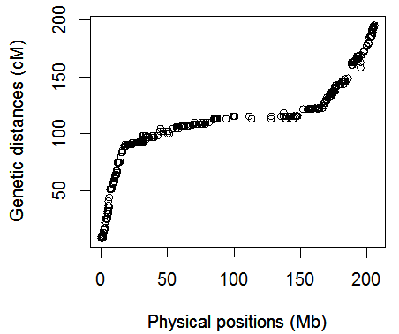
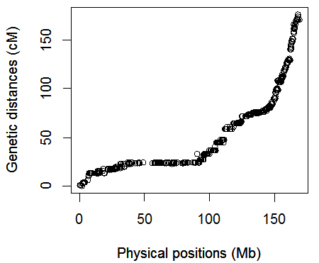
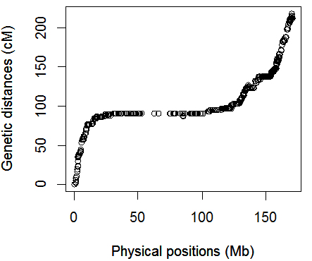
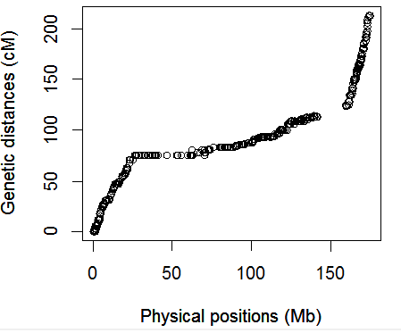
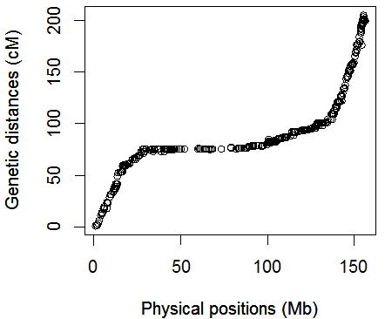
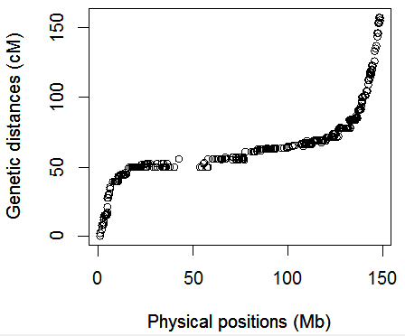
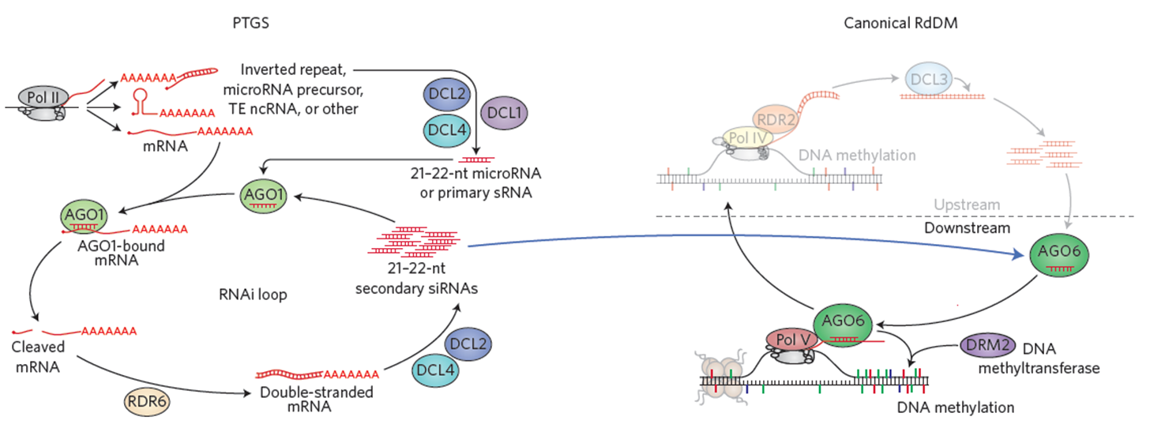
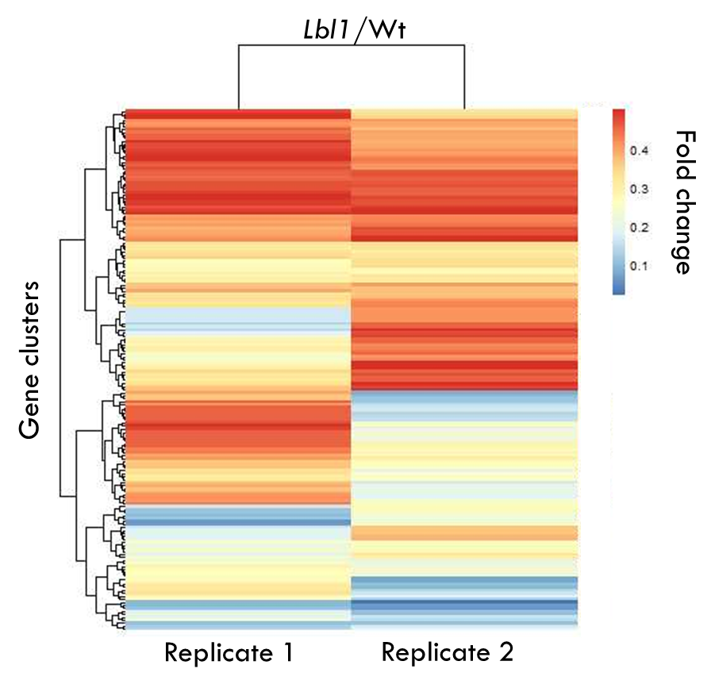



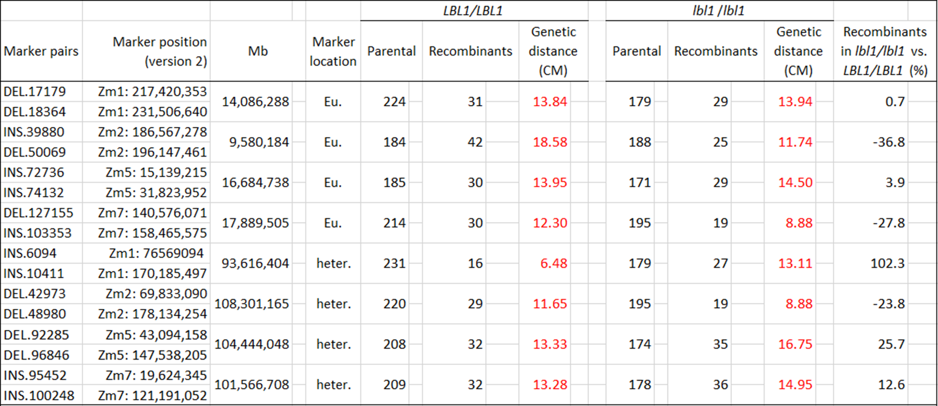
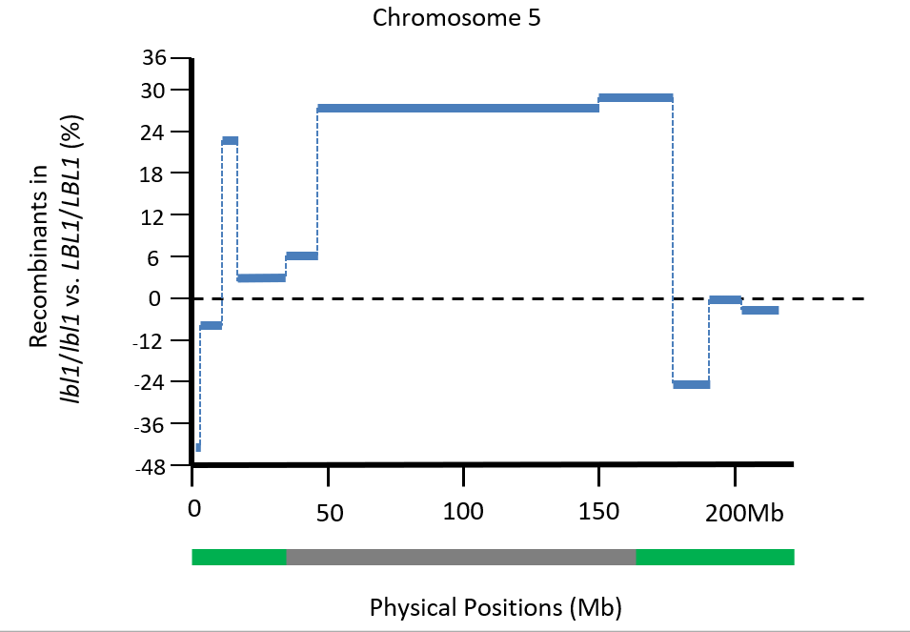
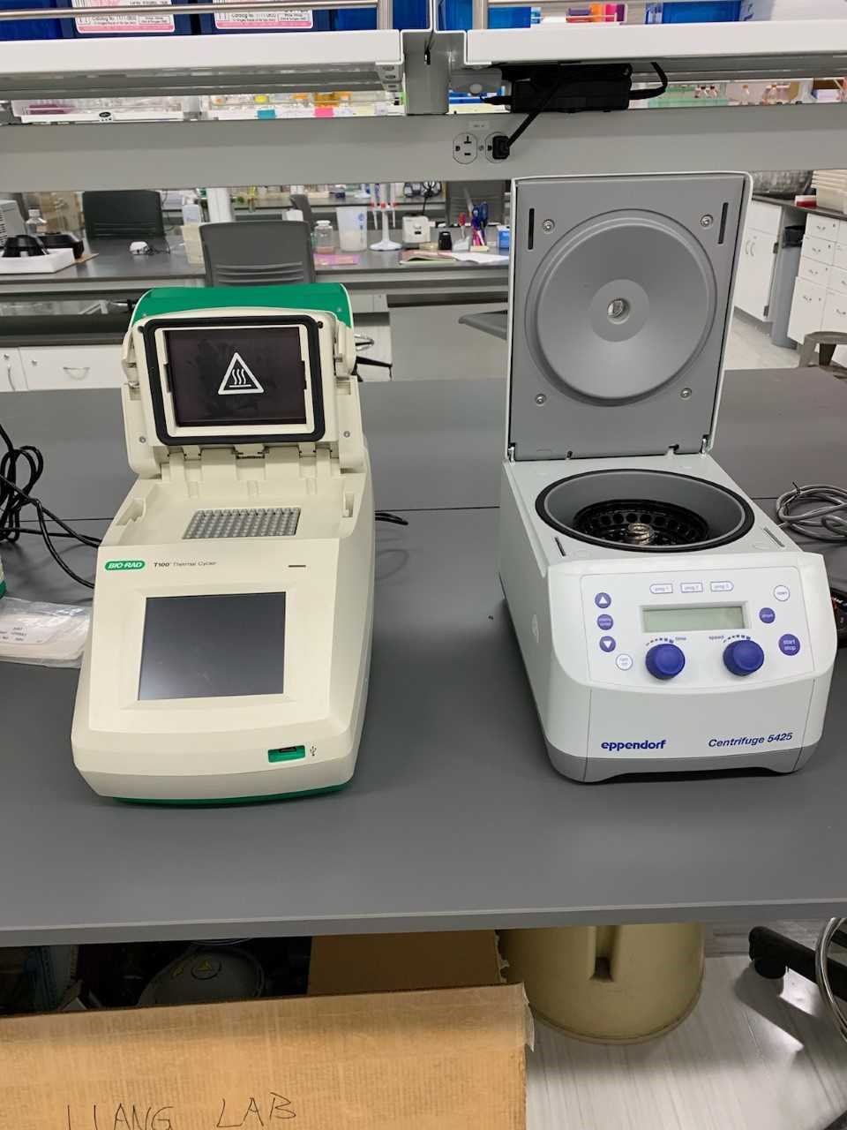
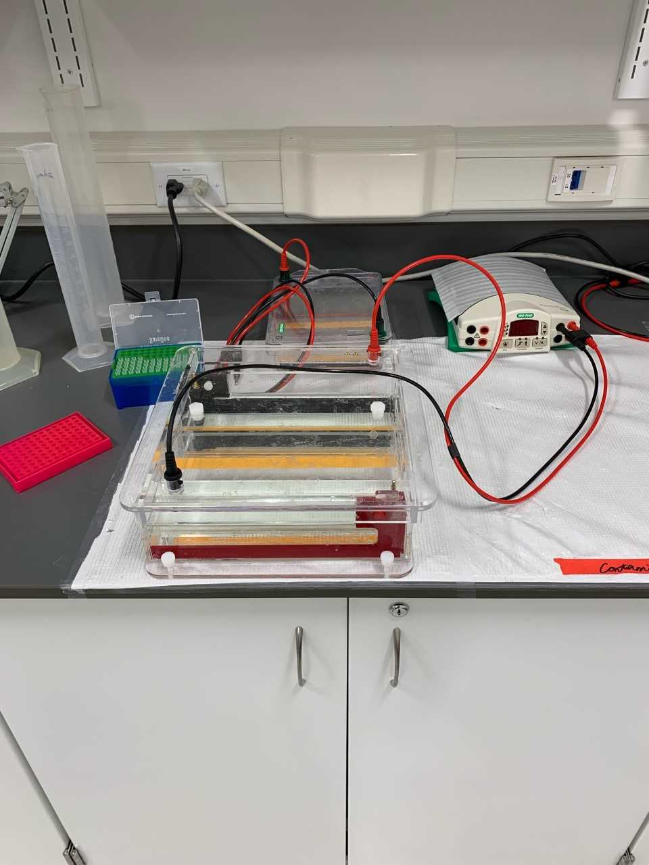
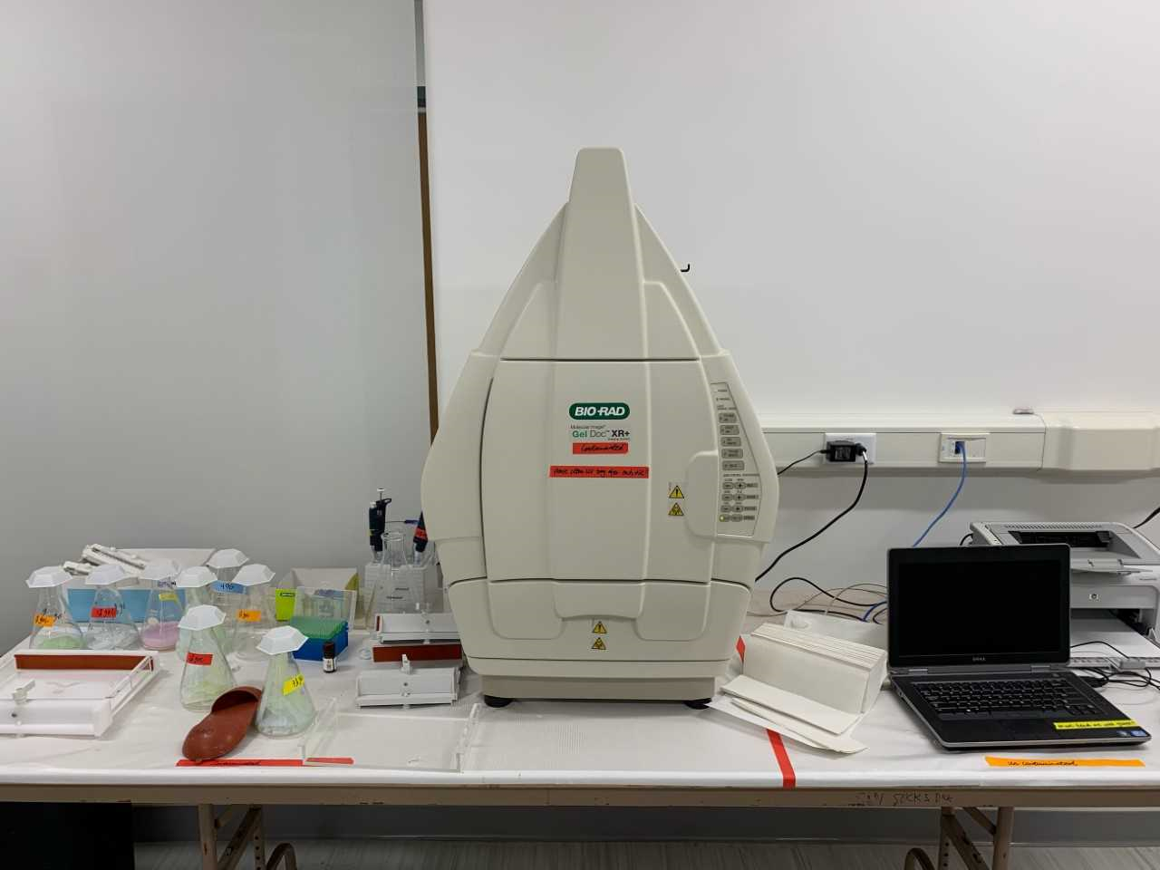
Determination of the effects of the lbl1 (leafbladeless1) mutation on meiotic recombination in maize
Tyshawn Ferrell^{1,2}, Damon Lisch³, Meixia Zhao¹
¹Department of Biology, Miami University, Oxford, OH, 45056
²Department of Biology, Albany State University, Albany, GA 31705
³Department of Botany and Plant Pathology, Purdue University, West Lafayette, IN, 47907
Meiotic recombination is a fundamental process that generates genetic diversity and ensures the accurate segregation of homologous chromosomes. Meiotic recombination is regulated by both genetic and epigenetic factors. While a great deal is known about genetic factors, relatively little is known about epigenetic factors, such as DNA methylation. We hypothesize that the removal of DNA methylation can alter the frequency of recombination. To test this hypothesis, we measured the meiotic recombination in a mutant named maize leafbladeless1 (lbl1), which can prevent the establishment of methylation by inhibiting the biogenesis of the small short interfering RNAs. In maize, we compared the number of crossovers in F2 families derived from lbl1 mutants and their wild type control siblings using polymorphic genetic markers. We observed no significant changes in the frequency of meiotic recombination in both the euchromatic and heterochromatic regions between the mutant and the wild type plants. We hypothesize that lbl1 may not alter the frequency of meiotic recombination globally, but rather, may only effect recombination at specific regions of the chromosomes where DNA methylation has been largely reduced in the mutants. We have begun to analyze high-throughput small RNA and whole genome bisulfite sequencing data in order to determine the identity of those regions. Our next step will be to develop new markers around those regions with largely reduced small RNAs and DNA methylation to investigate the frequency of meiotic recombination in the mutant and its wild type control. Our research will provide new insights into the understanding of how DNA methylation influence meiotic recombination.
INTRODUCTION
jjjjjjjjjjj
Global Production of 21-22nt small RNAs was slightly reduced in lbl1 mutants
Locations of marker pairs of the 10 maize chromosomes selected to compare the recombination frequencies between lbl1 mutant and wild type sibling
Chromatid structure affects recombination frequency
Recombination rate is negatively correlated with DNA methylation
The accumulation of 24nt siRNA is independent of SGS3/RDR6
The production of 21-22nt is dependent on SGS3/RDR6
Euchromatin
Zm1
Zm2
Zm3
Zm4
Zm5
Heterochromatin
recombination rates
Genetic distance (cM)
Genetic distance (cM)
Genetic distance (cM)
Genetic distance (cM)
Genetic distance (cM)
Euchromatin
Physical positions (Mb)
Physical positions (Mb)
Physical positions (Mb)
Physical positions (Mb)
Physical positions (Mb)
Yelina et al. 2012, PLoS Genetics
Zm6
Zm7
Zm8
Zm9
Zm10
A transcription fork model for RNA-directed DNA methylation (RdDM)
Genetic distance (cM)
Genetic distance (cM)
Genetic distance (cM)
Genetic distance (cM)
Genetic distance (cM)
Physical positions (Mb)
Physical positions (Mb)
Physical positions (Mb)
Physical positions (Mb)
Physical positions (Mb)
Whole genome bisulfite and small RNA sequencing of lbl1 mutant and wild type sidling
175 genes in lbl1 mutant were largely reduced in siRNA accumulation
RESULTS
No significant difference was observed in the meiotic recombination frequency between the lbl1 mutant and the wild type control
Summary of the small RNA and the whole genome bisulfite sequencing (WGBS) data
Sample |  | Genotype | Clean reads
Small RNA
 | 1147-9R | B73/Mo17;+/+ | 2,588,101
 | 1147-4R | B73/Mo17;lbl1/lbl1 | 28,004,402
 | 1147-12R | B73/Mo17;+/+ | 2,642,788
 | 1147-8R | B73/Mo17;lbl1/lbl1 | 28,750,664
WGBS
 | 1147-9D | B73/Mo17;+/+ | 85,335,357
 | 1147-4D | B73/Mo17;lbl1/lbl1 | 91,374,496
 | 1147-12D | B73/Mo17;+/+ | 80,276,151
 | 1147-8D | B73/Mo17;lbl1/lbl1 | 77,969,861
Cuerda-Gil and Slotkin, 2016, Nature Plants
Meiotic recombination rates in wild type and lbl1 do not show a significant difference in specific heterochromatic/euchromatic regions in chromosomes 1, 2, 5, and 7
MATERIALS & METHODS
Genetic strategies to construct the F2 populations and measure recombination frequency
A
B73;lbl1/+ x Mo17;lbl1/+
B
Mo17
B73
FUTURE PLANS
A
A
X
a
a
F1
B
B
A
a
b
b
Correlate the changes of F2 recombination frequencies with the whole genome bisulfite and small RNA data to determine the cause of changes in the lbl1 mutant
Develop polymorphic markers around specific regions with decrease siRNA/DNA methylation levels to measure meiotic recombination frequency in the mutant and wild type siblings.
Cytogenetic analysis of HEI10 foci during meiosis in the mutant and its wild type control.
B
b
F1
B73/Mo17;lbl1/lbl1
x
B73
B73/Mo17;lbl1/+
x
B73
B73/Mo17;+/+
x
B73
Gametes
Back cross
B73
A
a
A
a
x
a
B
b
b
B
b
F2
F2
F2
A
a
a
a
A
a
a
a
F2
measure recombination rates
B
b
b
b
b
b
B
b
Changes in meiotic recombination along the length of chromosome in 5 in lbl1 mutants compared to the wild type control
Parental
Recombinants
centimorgan (cM) = Recombinants/(Recombinants + Parental) * 100
ACKNOWLEDGEMENTS
C: Centrifuge 5425 and Thermal Cycler
D: Power pack and Sub-cell M96
E: Gel Doc XR+
This work was supported by Miami University to M.Z. and Funding was provided by a National Science Foundation Site grant (DBI-1156703).
REFERENCES
Lisch, D. (2012). Regulation of transposable elements in maize. Curr. Opin. Plant Biol. 15: 511–516.
Cuerda-Gil, D. and Slotkin, R.K. (2016). Non-canonical RNA-directed DNA methylation. Nat Plants 2: 16163.
Yelina NE, Choi K, Chelysheva L, Macaulay M, de Snoo B, et al. (2012) Epigenetic Remodeling of Meiotic Crossover Frequency in Arabidopsis thaliana DNA Methyltransferase Mutants. PLOS Genetics 8: e1002844.
Mirouze, M., Lieberman-Lazarovich, M., Aversano, R., Bucher, E., Nicolet, J., Reinders, J., & Paszkowski, J. (2012). Loss of DNA methylation affects the recombination landscape in Arabidopsis. Proc Natl Acad Sci USA 109: 5880–5885.
Notes:
I added the reference to the pictures and for some reason the format shifted some images.

